Slide 1





Web Application and Spring
GV: Đinh Doãn Phú

Slide 2
Day 1
1
2
3

Slide 3
Web Application Architecture
Content
1
Spring framework
2
Setup & Demo
3

Slide 4
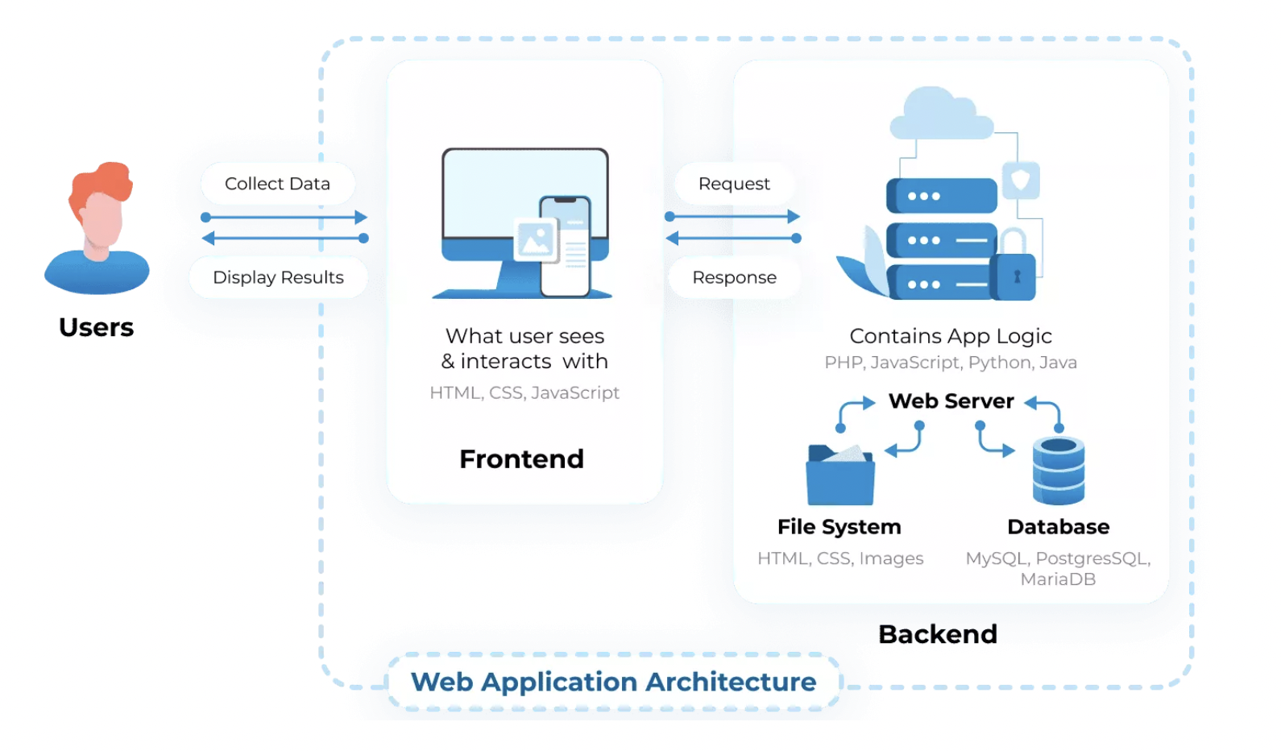
Web Application Architecture
1
2
3

Slide 5
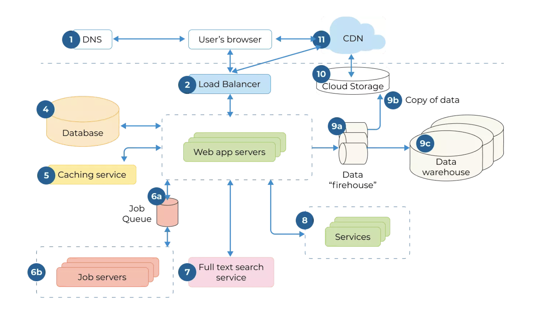
Web Application Architecture
1
2
3

Slide 6
Model of Web App Architecture
One Web Server, One Database
Multiple Web Servers, One Database
Multiple Web Server, Multiple Databases
1
2
3

Slide 7
Type of Web App Architecture
Single-Page Application (SPAs)
Server-Side Rendered Application (SSR)
Microservices
Serverless Architecture
1
2
3

Slide 8
Spring framework
1
2
3
Notes:
templates for JDBC, Hibernate, JPA
abstraction
: JMS, JDBC, JPA and JTA

Slide 9
Advantages of Spring Framework
Advantages
Predefined Templates
Loose Coupling
Easy to test
Lightweight
Fast Development
Powerful abstraction
Declarative support
1
2
3
Notes:
templates for JDBC, Hibernate, JPA
abstraction
: JMS, JDBC, JPA and JTA

Slide 10
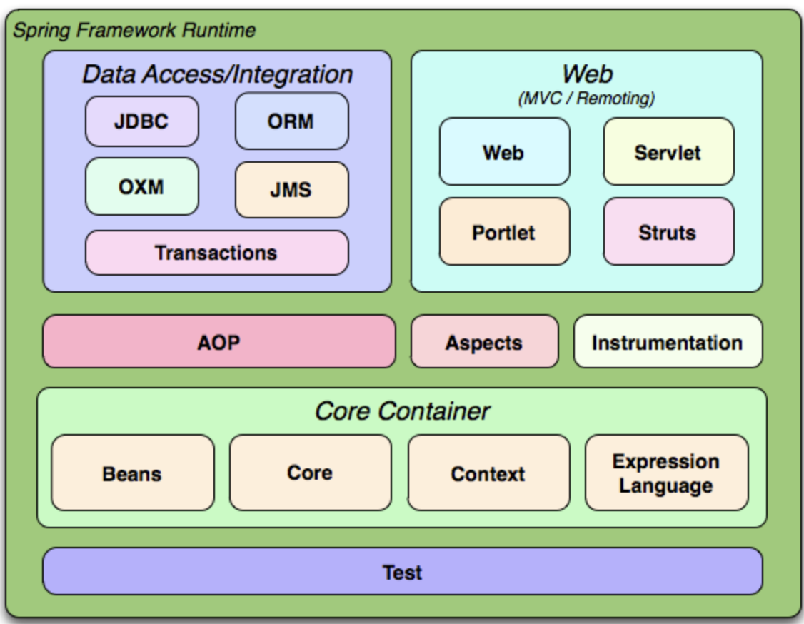
Spring Framework
1
2
3

Slide 11
Tools
STS/plugin
Maven
Tomcat
Lombok
Git…
Postman
1
2
3

Slide 12
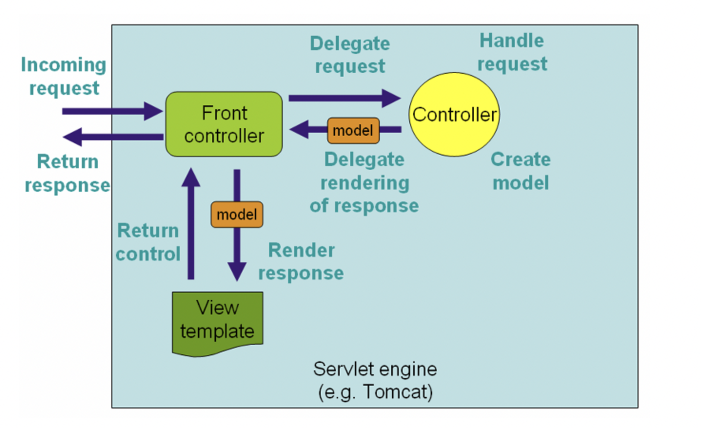
Spring MVC
1
2
3
Notes:
Refer: https://docs.spring.io/spring-framework/docs/3.2.x/spring-framework-reference/html/mvc.html

Slide 13
Demo & QA
1
2
3

Slide 14
Day 2
1
2
3

Slide 15
RESTful API
Content
1
Spring Boot
2
Thymeleaf & Demo
3

Slide 16
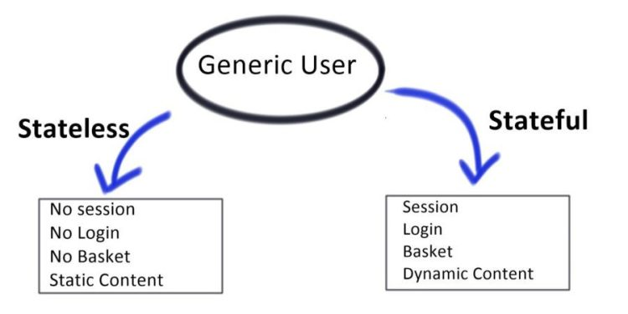
Stateless and stateful
1
2
3

Slide 17
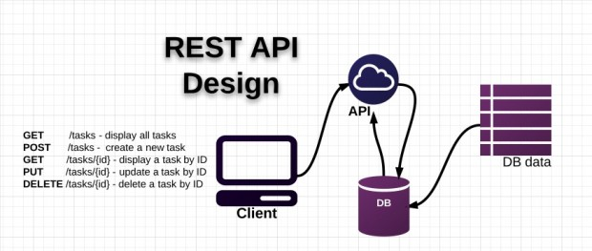
REST API Design
1
2
3

Slide 18
REST API
RESTful API
Use of a uniform interface
Client – Server
Stateless
RESTful Resource caching
Layered system
Code on demand (XML, JSON)
1
2
3
Notes:
Những tiêu chí để một API được coi là RESTful

Slide 19
Status code
200 OK
400 Bad request
404 Not found
500 Internal Server Error
1
2
3
Notes:
Những tiêu chí để một API được coi là RESTful

Slide 20
Http method
GET (SELECT): return one or list Resource
POST (CREATE): create new Resource.
PUT (UPDATE): update Resource.
DELETE (DELETE): Delete a Resource.
1
2
3
Notes:
Những tiêu chí để một API được coi là RESTful

Slide 21
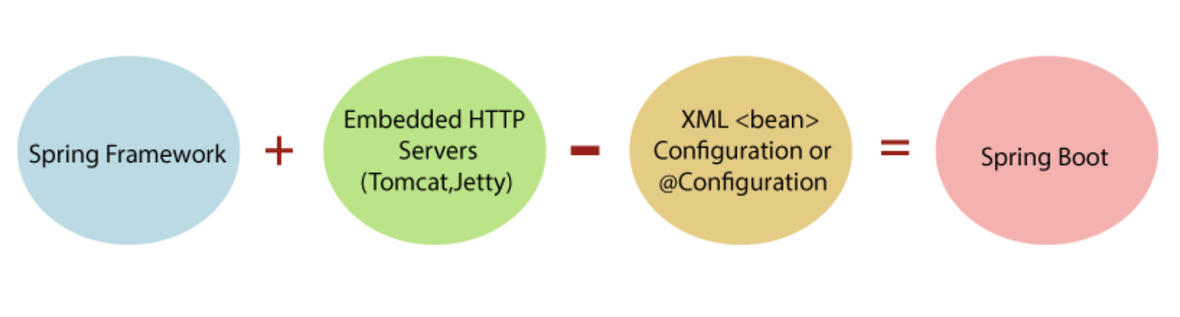
Spring boot
1
2
3
Notes:
Những tiêu chí để một API được coi là RESTful

Slide 22

Spring boot - Config
1
2
3
Notes:
Những tiêu chí để một API được coi là RESTful

Slide 23
Spring boot - Example
GET
POST
PUT
DELETE
1
2
3
Notes:
Cài Postman

Slide 24
Spring boot - Example
Thymeleaf
1
2
3
Notes:
https://www.thymeleaf.org/doc/tutorials/3.0/thymeleafspring.html#model-attributes

Slide 25
Day 3
1
2
3

Slide 26
IOC Container
1
2
3

Slide 27
Dependency Injection
1
2
3

Slide 28
AOP
1
2
3

Slide 29
ANNOTATION
1
2
3

Slide 30


Q&A
30

Slide 31




